Slide 1
PBL – Project
FY B.Tech ( COMP/ MECH/ EXTC/IT/EXCP/CCE/AIDS/RAI Semester II ( 2023-24)
Pradyum Mistry:16010123236
Praneet Sharma:16010123237
Pratik Patil:16010123238
Prisha Surve:16010123239
Priya Gouda:16010123240

Slide 2
Theme chosen for Project
Waste Management and Smart City:
Home Cleaning Robot

Slide 3
Need Statement
A Home cleaning robot can help to clean the floor with minimal efforts. Useful for busy individuals or people having mobility issues, as it autonomously cleans carpets and floors saving time and energy. Additionally, regular cleaning can improve the air quality by removing dust and allergens which can overall help to build a healthy environment. By scheduling regular cleanings this robot will also help to maintain a consistently clean living space. With smart features you can manage the cleaning robot from anywhere and anytime. Overall this home cleaning robot offers convenience, consistency, smart home integration and health benefits.

Slide 4
Problem Statement
A]LIST OF OBJECTIVES:
Implement effective cleaning mechanisms for surface.
Maintain cost-effectiveness while delivering high performance
B]FUNCTIONS:
Cleans floors using brushes/wipers.
Compact design for maneuvering under furniture.
Quiet operation for minimal disturbance.
C]CONSTRAINTS:
Battery Life:We need to optimize the battery life to ensure that the Roomba works for a sufficient amount of time .Therefore choosing a proper type battery is important.
Edge Cleaning: It can be difficult to build a mechanism which efficiently cleans the edges where most of the dust accumulates.
Cost Constraints:Balancing the features of the Roomba and its quality can be difficult with a limited amount of budget.
Integration with Smart Home Systems:It should be able to connect with the wifi or bluetooth.
D]FINAL PROBLEM STATEMENT:
Develop a home cleaner with floor-cleaning brushes, compact design for furniture maneuverability, and quiet operation to minimize disturbance.

Slide 5
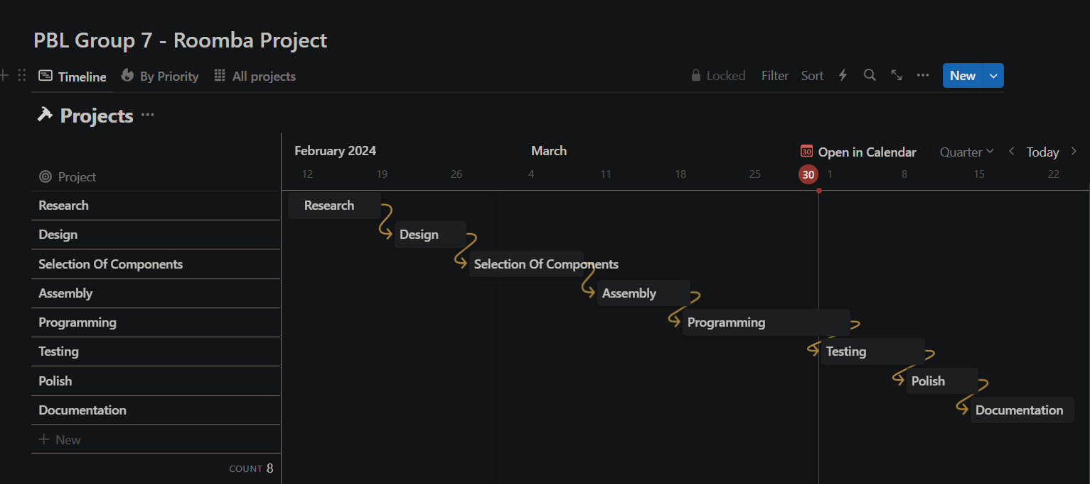
Time line Chart

Slide 6
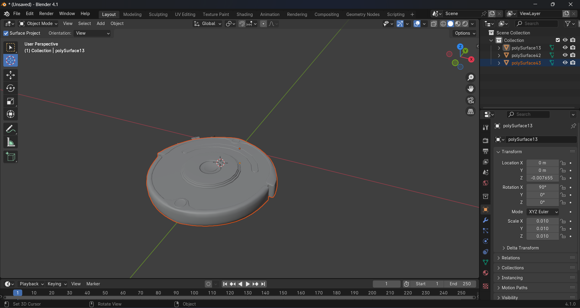
Conceptual Designs
Rough Sketches / Model of possible solutions – 1 or 2 at least

Slide 7
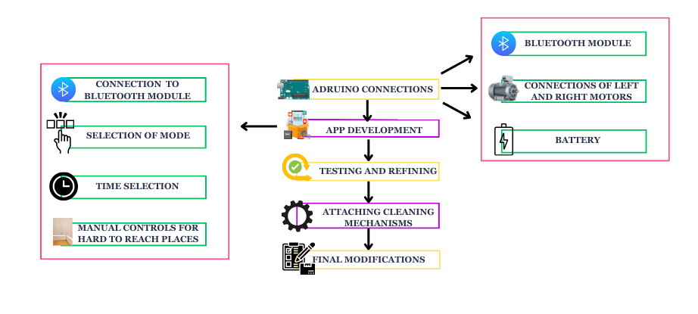
Block Diagram of Project

Slide 8
Hardware / Software Requirements
Hardware Components:
Arduino Uno
L298N Dual H Bridge Stepper Motor Driver Board
Motor with wheels
Jumper Cables
Bluetooth Module
Batteries
Misc
Software Components:
1.Arduino IDE
2.Unity Engine (For App Development)

Slide 9
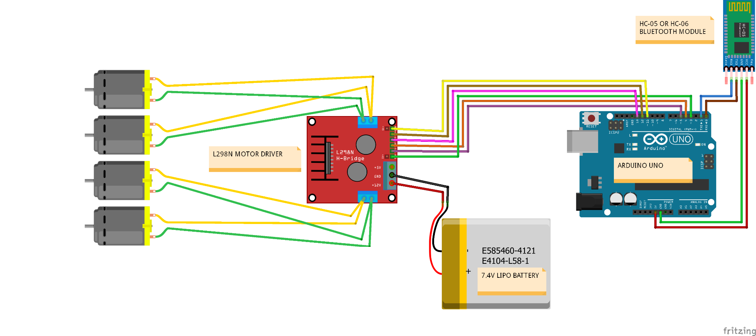
Proposed Circuit / Connection Diagram

Slide 10
Project Cost Sheet
Name of Component | Specifications | Approximate cost
Arduino Uno | 1 | Rs.489
L298N Dual H Bridge Stepper Motor Driver Board | 2A, 5V | Rs.240
Motor with wheels | 3 ~ 12V 200 rpm | Rs.349

Slide 11
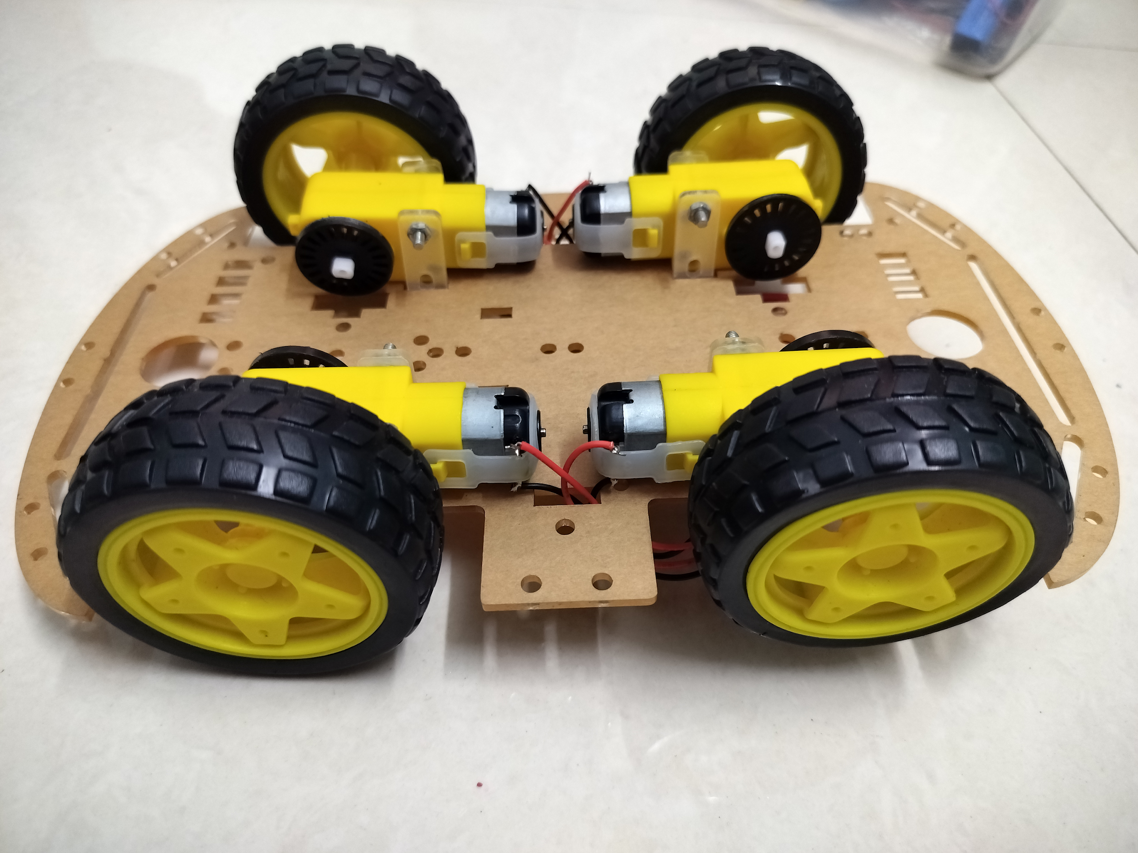
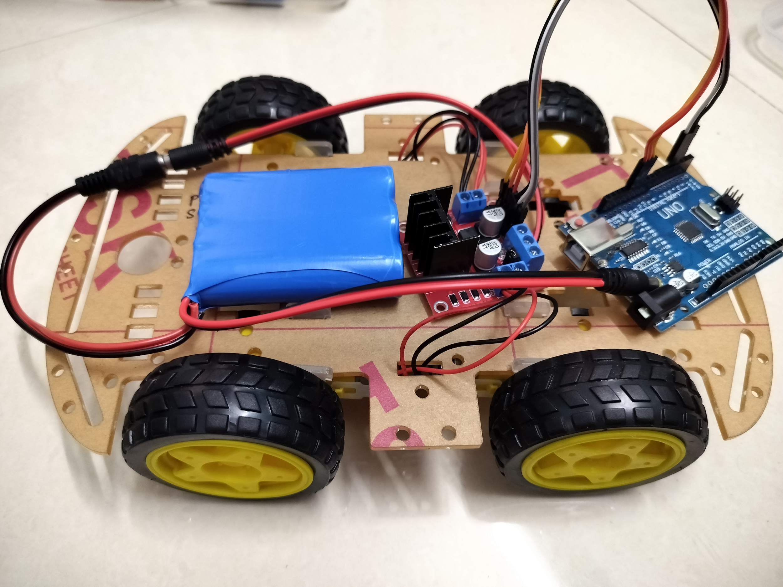
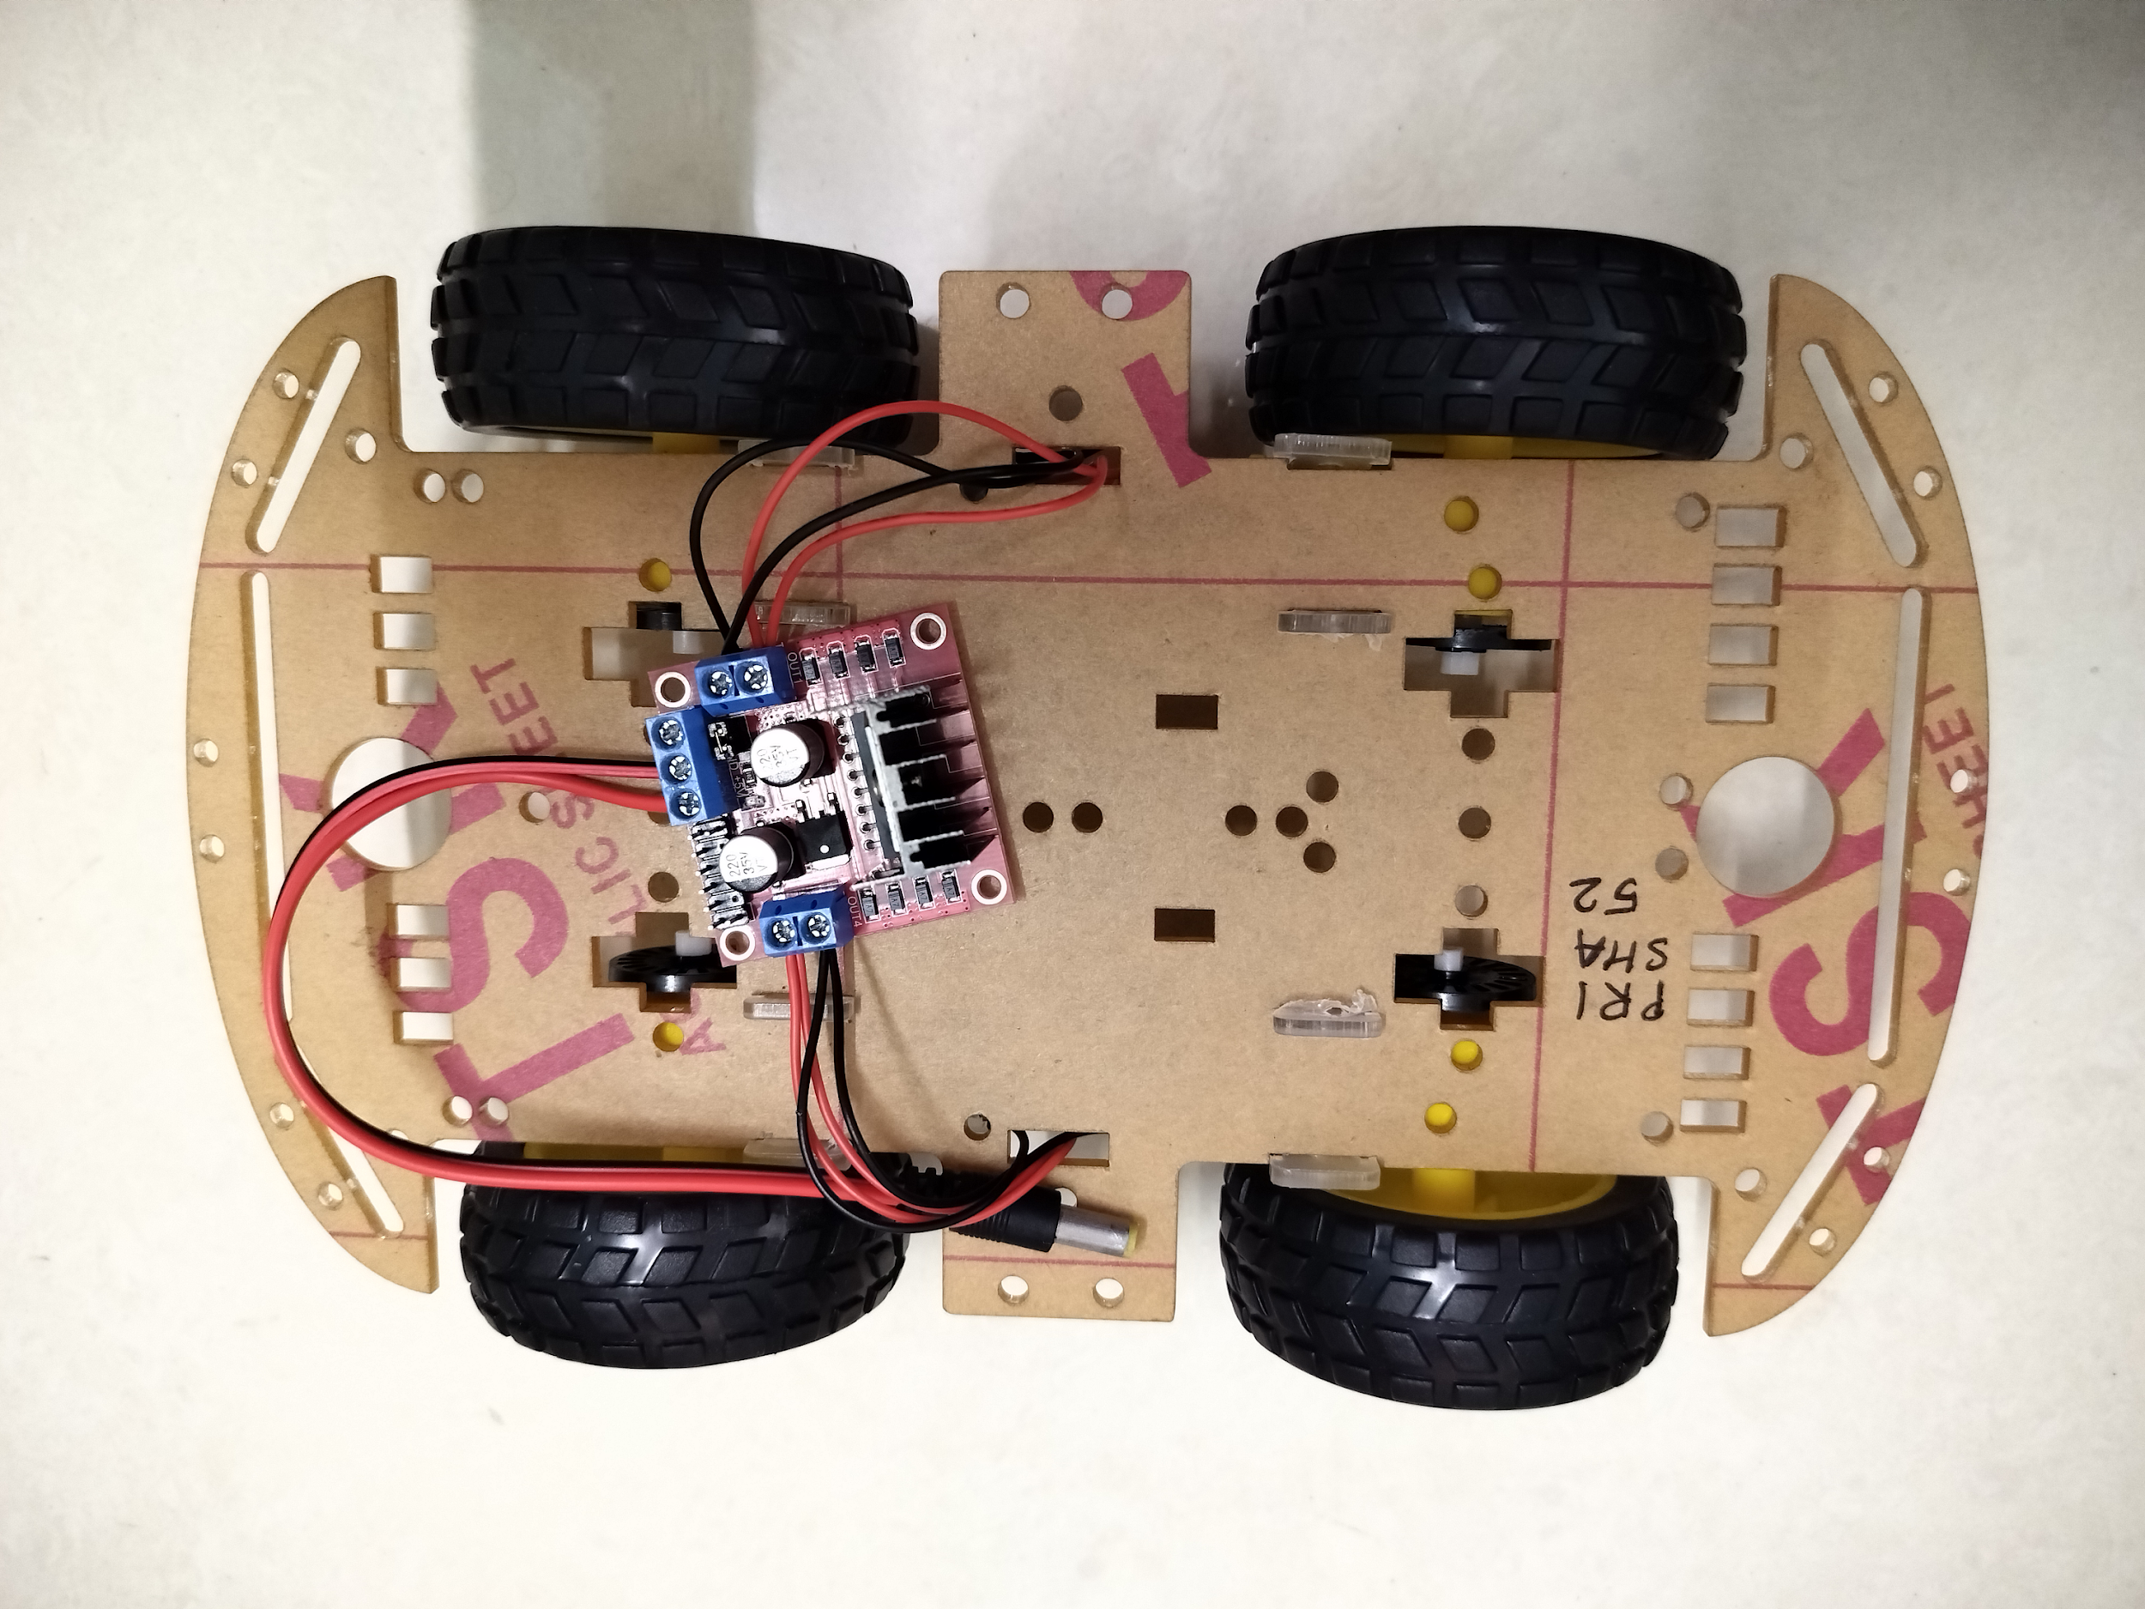
Results
Photographs of the model

Slide 12
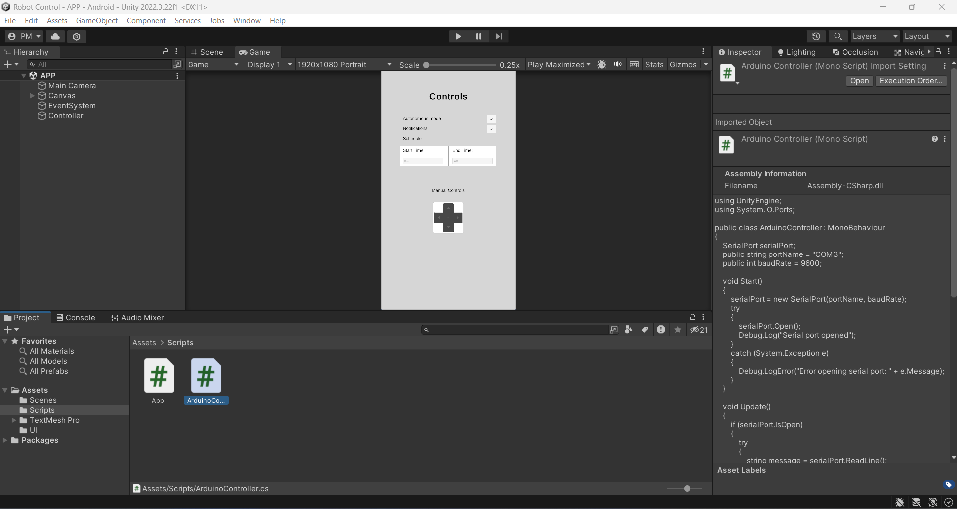

Slide 13
Results
Additional results / Observations/ Limitations
Github: https://github.com/altf4-games/Home-Cleaning-Robot

Slide 14
Future Scope
Recycling Integration: Robot can identify and separate recyclable materials.
Sustainability Focus: Incorporates eco-friendly features for reduced environmental impact.
Waste Sorting Capability: AI enables identification and sorting of various waste types.
Collaborative Waste Handling: Assists in waste collection and disposal, reducing manual effort.

Slide 15
Conclusion and your learnings
Creating a home cleaning robot project was a valuable learning experience. It showed us how combining robotics, AI, and engineering can solve real-world problems through teamwork and innovation. We learned the importance of user-friendly design and continuous testing, highlighting the significance of understanding user needs. Overall, it was a rewarding journey that showcased the complexities and rewards of developing innovative solutions in robotics and engineering.

Slide 16
References
https://www.researchgate.net/publication/341162912_Smart_Vacuum_Robot
https://www.thezebra.com/resources/home/how-roomba-works/
https://www.thinkcrucial.com/blogs/blog/top-10-reasons-you-should-buy-a-robotic-vacuum

